Slide 1

UNIVERSITY INSTITUTE OF ENGINEERING
COMPUTER SCIENCE ENGINEERING
ARTIFICIAL INTELLIGENCE
(21CSH-611/621)
INTRODUCTION
DISCOVER . LEARN . EMPOWER

Slide 2
IDA*
Series of Depth-First Searches
Like Iterative Deepening Search, except
Use A* cost threshold instead of depth threshold
Ensures optimal solution
QueuingFn enqueues at front if f(child) <= threshold
Threshold
h(root) first iteration
Subsequent iterations
f(min_child)
min_child is the cut off child with the minimum f value
Increase always includes at least one new node
Makes sure search never looks beyond optimal cost solution

Slide 3
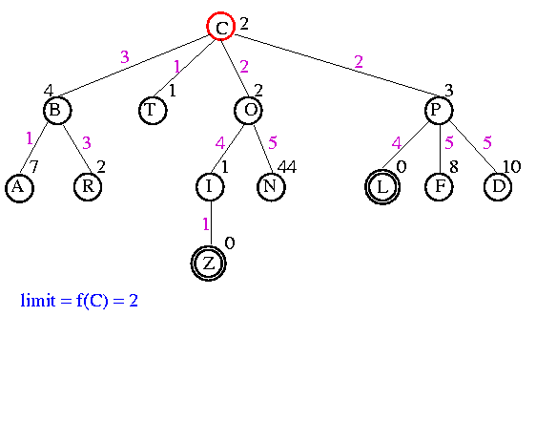
Example

Slide 4
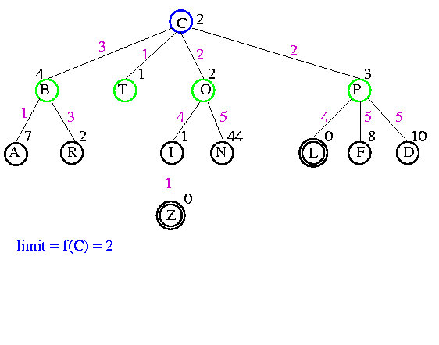
Example

Slide 5
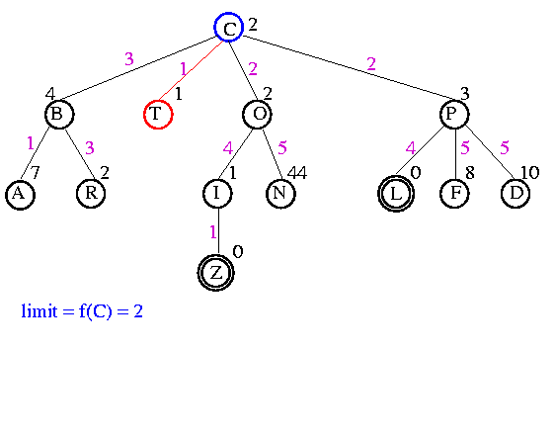
Example

Slide 6
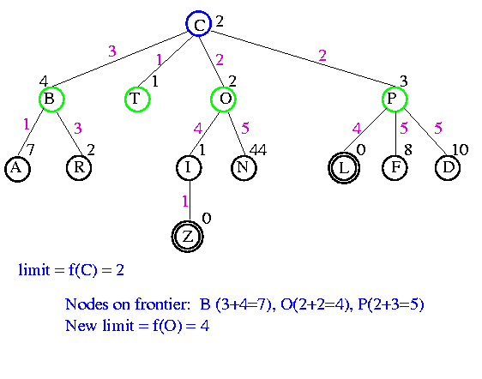
Example

Slide 7

Example

Slide 8
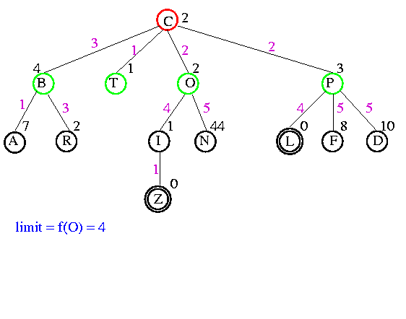
Example

Slide 9
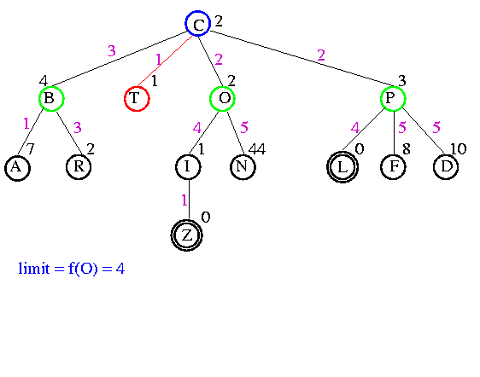
Example

Slide 10
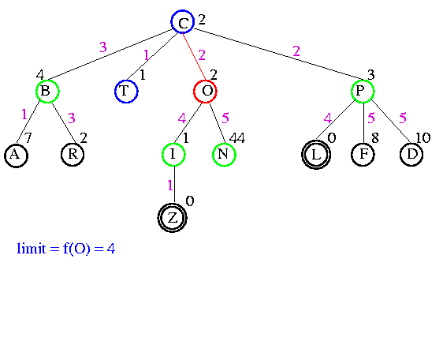
Example

Slide 11
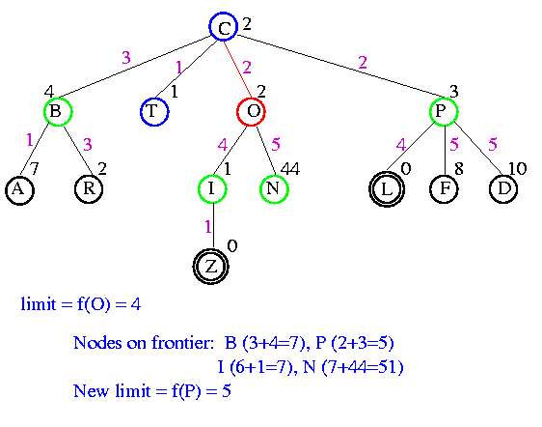
Example

Slide 12


Example

Slide 13

Example

Slide 14
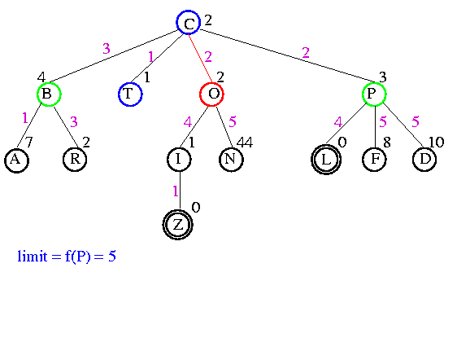
Example

Slide 15
Example

Slide 16
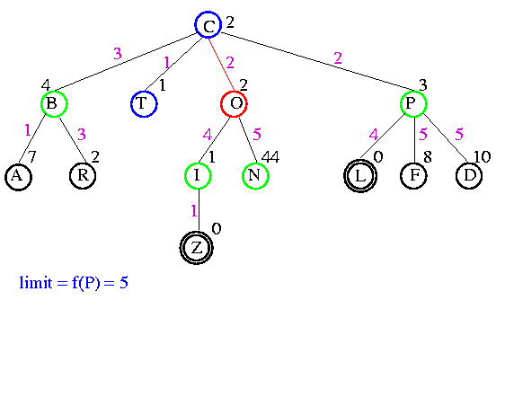
Example

Slide 17
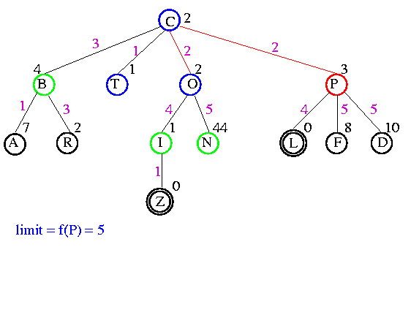
Example

Slide 18
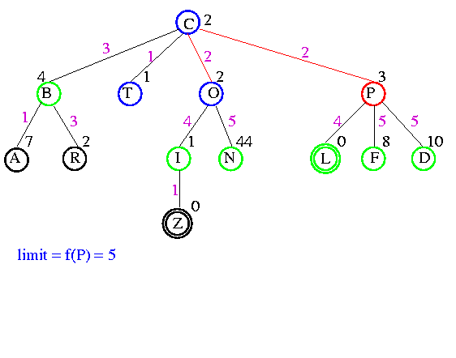
Example

Slide 19
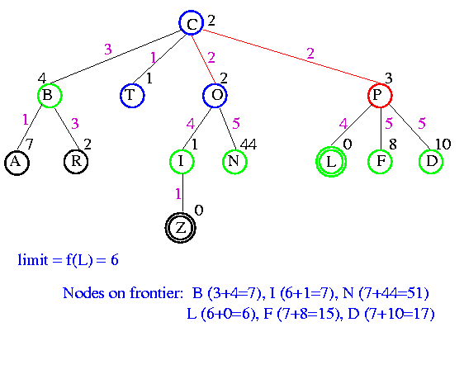
Example

Slide 20

Example

Slide 21

Example

Slide 22

Example

Slide 23

Example

Slide 24
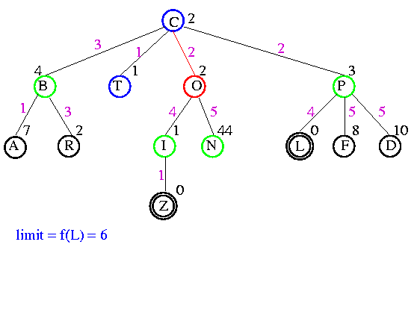
Example

Slide 25

Example

Slide 26
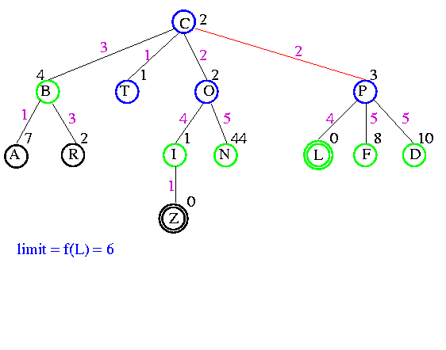
Example

Slide 27
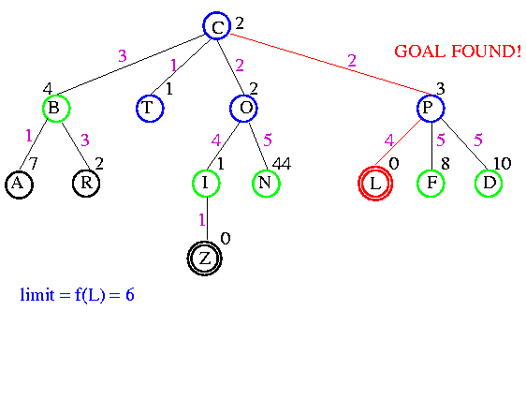
Example

Slide 28
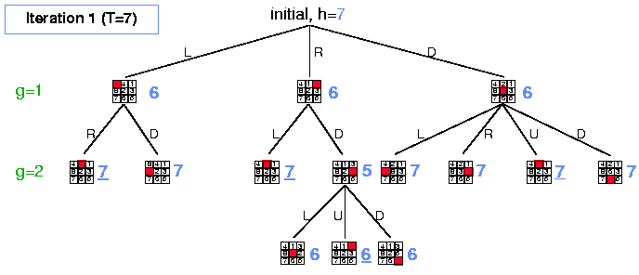
Example

Slide 29
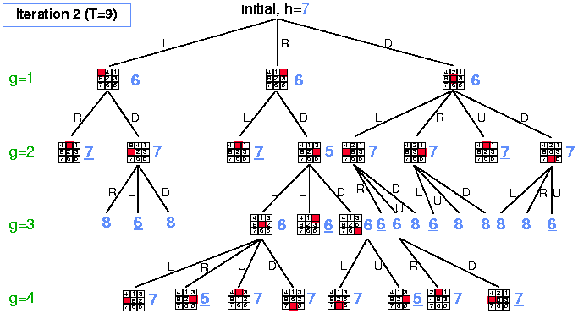
Example

Slide 30
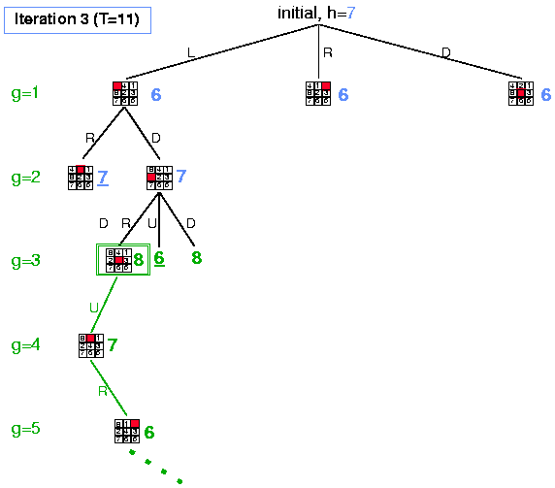
Example

Slide 31
Analysis
Some redundant search
Small amount compared to work done on last iteration
Dangerous if continuous-valued h(n) values or if values very close
If threshold = 21.1 and value is 21.2, probably only include 1 new node each iteration
Time complexity is O(b^{m})
Space complexity is O(m)

Slide 32

Comparison of Search Techniques
 | DFS | BFS | UCS | IDS | Best | HC | Beam | A* | IDA*
Complete | N | Y | Y | Y | N | N | N | Y | Y
Optimal | N | N | Y | N | N | N | N | Y | Y
Heuristic | N | N | N | N | Y | Y | Y | Y | Y
Time | b^{m} | b^{d+1} | b^{m} | b^{d} | b^{m} | bm | nm | b^{m} | b^{m}
Space | bm | b^{d+1} | b^{m} | bd | b^{m} | b | bn | b^{m} | bm

Slide 33
THANK YOU

